Slide 1
Object Oriented Development with Java (CT038-3-2 and Version VC1)
Packages

Slide 2
Topic & Structure of The Lesson
Introduction
Using Packages
Accessing Packages
Packages Naming Conventions
Package Declaration
Adding Class to a Package

Slide 3
Learning Outcomes
At the end of this topic, You should be able to
-Describe about package
-Describe how to Use and access a
package
-Describe how to Add a class to a
Package

Slide 4
Key terms you must be able to use
If you have mastered this topic, you should be able to use the following terms correctly in your assessments:
Package
Jar files
Library

Slide 5
Introduction
Packages are nothing more than the way we organize files into different directories according to their functionality, usability as well as category they should belong to .
A Java package is a Java programming language mechanism for organizing classes into namespaces.

Slide 6
Intoduction
Java source files belonging to the same category or providing similar functionality can include a package statement at the top of the file to designate the package for the classes the source file defines.
Java packages can be stored in compressed files called JAR files.
An obvious example of packaging is the JDK package from SUN (java.xxx.yyy) as shown below:

Slide 7
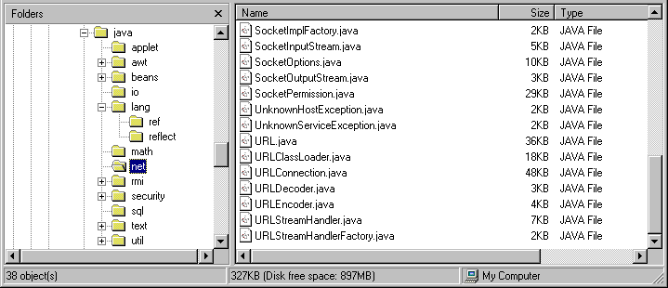

Slide 8
Introduction
Packaging also help us to avoid class name collision when we use the same class name as that of others.
For example, if we have a class name called "Vector", its name would crash with the Vector class from JDK. However, this never happens because JDK uses java.util as a package name for the Vector class (java.util.Vector ).
Understanding the concept of a package will also help us manage and use files stored in jar files in more efficient ways.

Slide 9
Using Packages
To use a package inside a Java source file, it is convenient to import the classes from the package with an import statement.
import java.awt.event.*;
The above statement imports all classes from the java.awt.event package.

Slide 10
Package access protection
Classes within a package can access classes and members declared with default access and class members declared with the protected access modifier.
Default access is enforced when neither the public, protected nor private access modifier is specified in the declaration.

Slide 11
Creation Of Jar Files
In Java source files the package the file belongs to is specified with the package keyword .
package java.awt.event;
JAR Files are created with the jar command-line utility.
The command “jar cf myPackage.jar *.class” compresses all *.class files into the JAR file myPackage.jar.

Slide 12
Package Naming Conventions
Packages are usually defined using a hierarchical naming pattern, with levels in the hierarchy separated by periods (.) .
Although packages lower in the naming hierarchy are often referred to a "subpackages" of the corresponding packages higher in the hierarchy, there is no semantic relationship between packages.

Slide 13
Package Declaration
Package declaration is file based;
All classes in the same source file belong to the same package.
Each source file may contain an optional package declaration in the following form.
Package packagename;
Let us consider the source file ElevatorFrame.java, for example.
Package elevator;
Public class ElevatorFrame
{ public double x; //……..}

Slide 14
Package Declaration
The package declaration at the top of the source file declares that the ElevatorFrame class belongs to the package named elevator.
When the package declaration is absent from a file, all the classes contained in the file belong to unnamed package.
A class in a named package can be referred in two ways.

Slide 15
Using Packages
Class in a named package can be referred to in two different ways
Using the fully qualified name packagename.ClassName
We can refer to the ElevatorPanel class in package elevator as
elevator.ElevatorPlanel

Slide 16
Importing a class in the package
Importing the class using the simple class name
We can import a class or all the classes in the designated package using
Import packagename.ClassName;
Import packagename.*;
The ElevatorPanel class in package elevator can simply be referred to as elevator when either of the following import clauses occurs at the top of source file
Import elevator.ElevatorPanel;
Import elevator.*;

Slide 17
Quick Review Question
What is Package
How to access a Package
How to declare a Package

Slide 18
Summary of Main Teaching Points
-Introduction
-Using Packages
-Accessing Packages
-Packages Naming Conventions
-Package Declaration
-Adding Class to a Package

Slide 19
Question and Answer Session
Q & A

Slide 20
Next Session
Exception Handler
Exception Class
Handling Exception
Handling multiple exceptions
finally clause
Checked and unchecked exceptions
throw exception
Creating (your own) exception class

